Slide 1

HW4: DCGAN
Tutorial
Due: 6/8 11:59 pm, 2021

Slide 2
Open the sample code in colab
https://colab.research.google.com/drive/1qYeX6oG8Kem-JngmI72mUkKLoz8JDCZx?usp=sharing

Slide 3
Walkthrough the Code

Slide 4
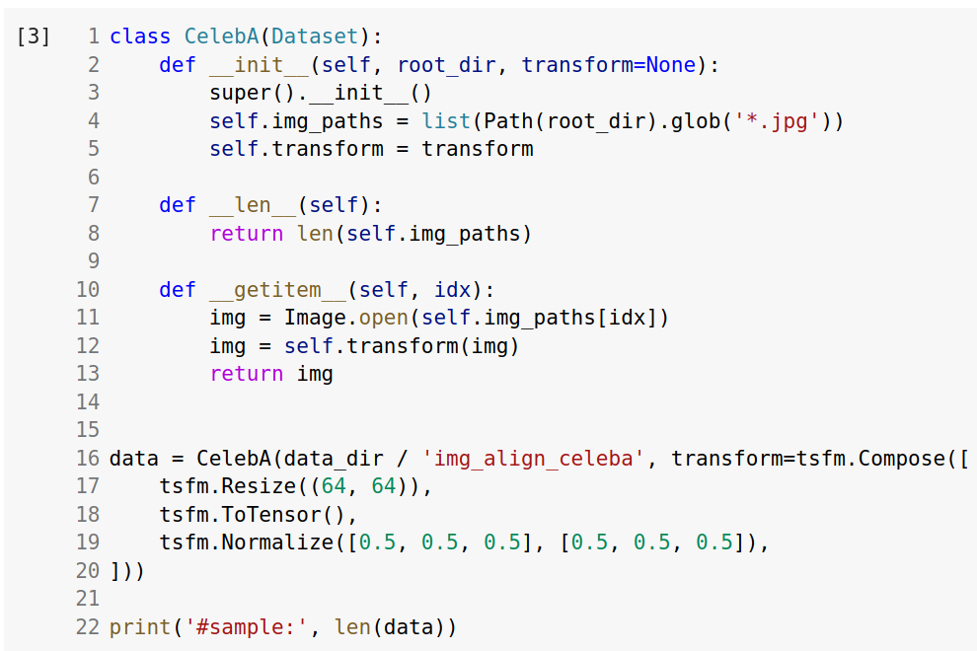
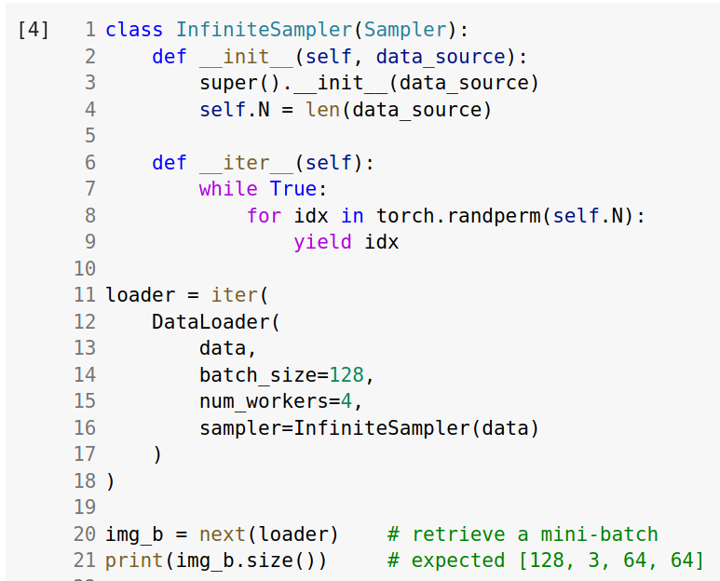
Dataset and Dataloader

Slide 5
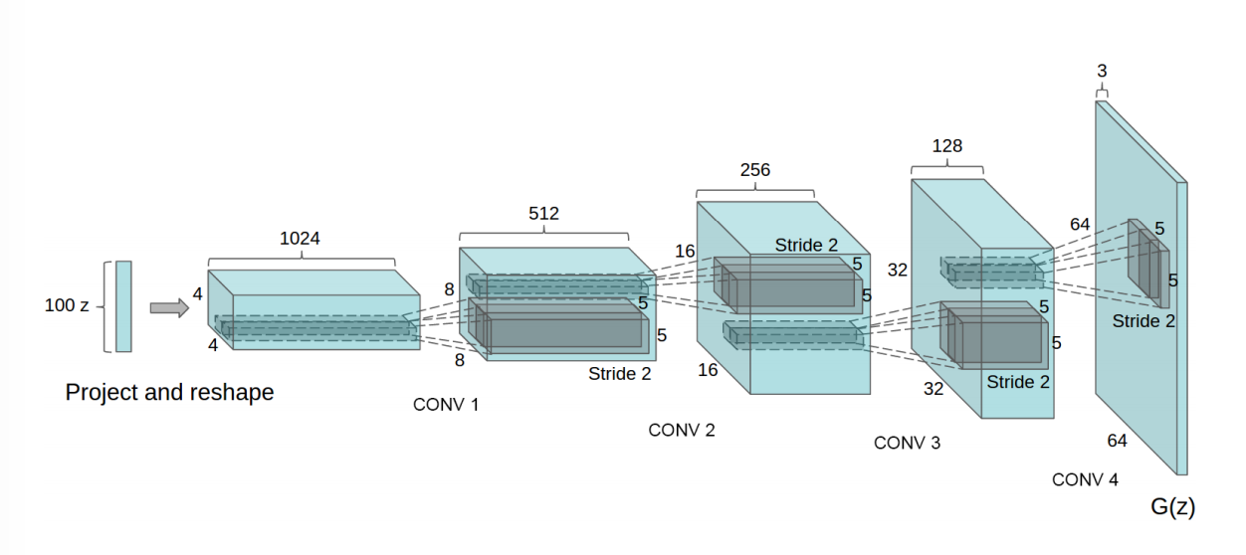

Generator & Discriminator
This is the generator used in origin paper.
In our implementation, we use only half the channels.
Convolution & Transposed Convolution

Slide 6
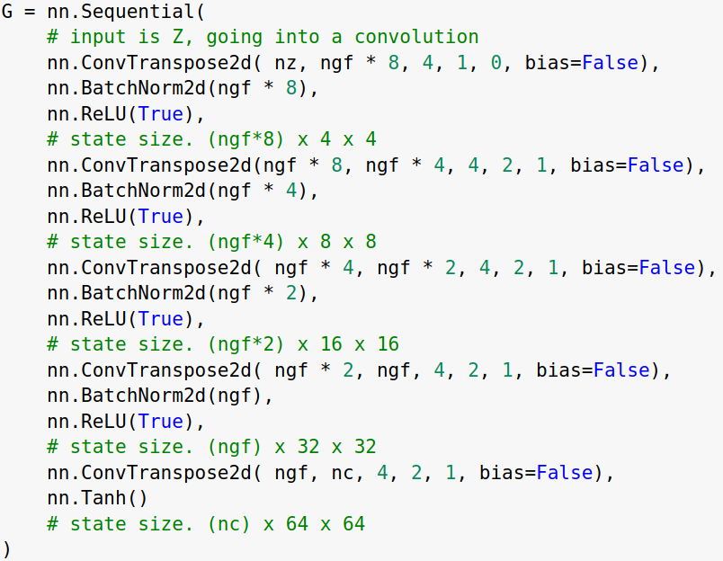
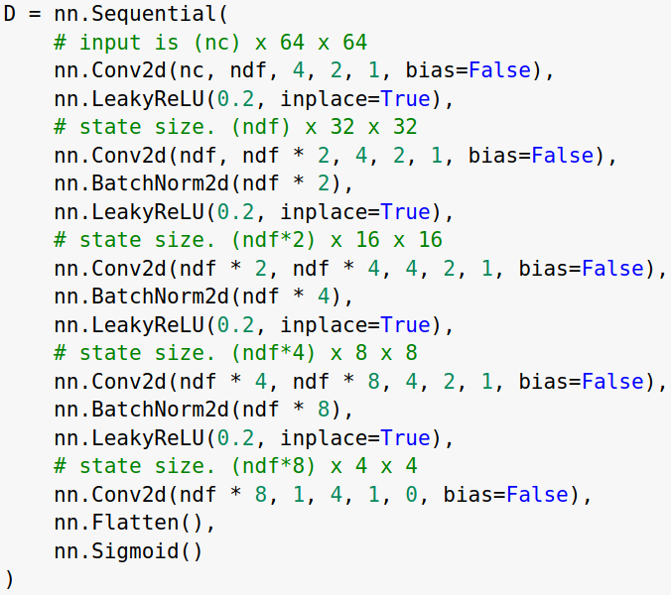
Generator & Discriminator
Generator
(N, 100, 1, 1) → (N, 3, 64, 64)
Discriminator
(N, 3, 64, 1) → (N, 1)

Slide 7
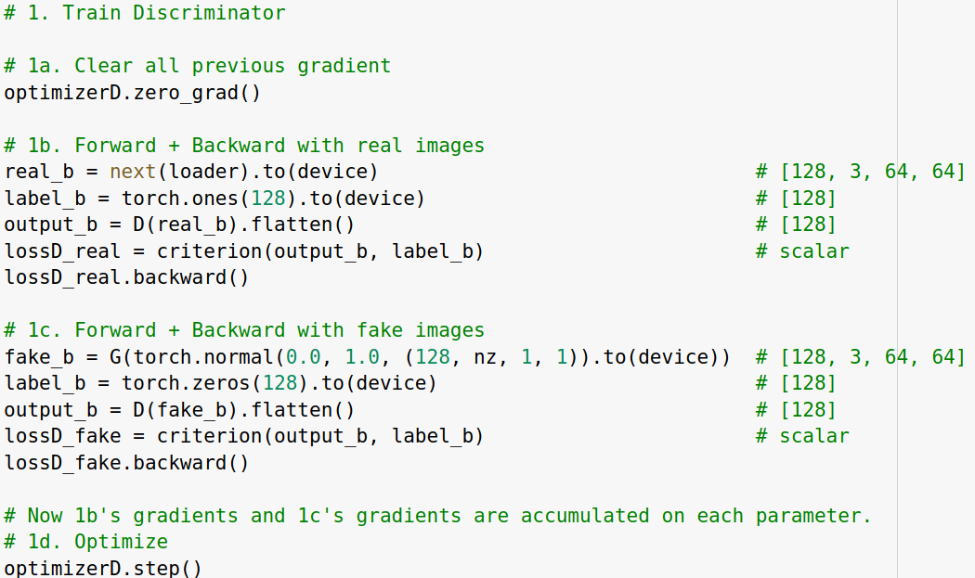
Training
real image
D
score
Fixed
z
G
fake image

Slide 8
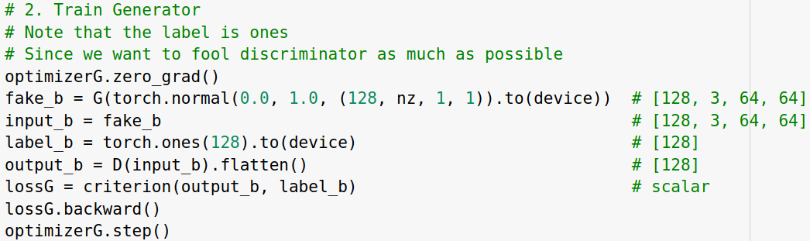
Training
Fixed
D
score
z
G
fake image

Slide 9
Requirements

Slide 10
Run the sample code and answer the following questions:
Q1.
Compare the visualization images after step 0, 200, 1000, 2500, 5000.
Q2.
Why can't we see the typical loss descreasing in generator and discriminator's loss curve?

Slide 11
Run the sample code and answer the following questions:
Q3.
1. Generating Fake Images using N(0, 1)
2. Generating Fake Images using N(-10, 1)
3. Generating Fake Images using U(0, 1)

Slide 12
Run the sample code and answer the following questions:
Q4.
Why the result of Q3.2 looks so weird, i.e., Why our generator fails at generating images using latent vector following distribution N(−10,1)?
Q5.
Why the result images of Q3.3 looks so similar to each other?

Slide 13
Submit the codes and report before 6/8 11:59 pm
PDF report include:
colab URL
execution results
answers of each question (Q1~Q5)
conclusion
Discussion
Turn in the compressed file and format the file name as: Student ID_proj4_v1

